Slide 1
Solving the Replication Crisis Or Why it’s the most exciting time to be a scientist
Rick Klein
Université Grenoble Alpes

Slide 2
Overview
Briefly remind about the replication crisis
Discuss work to understand replication
(Many Labs 2)
Discuss solutions

Slide 3
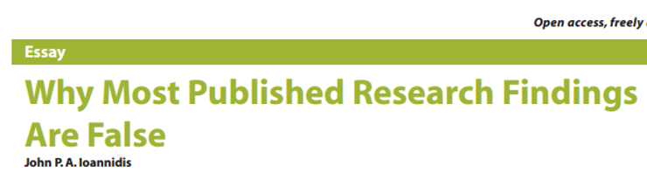
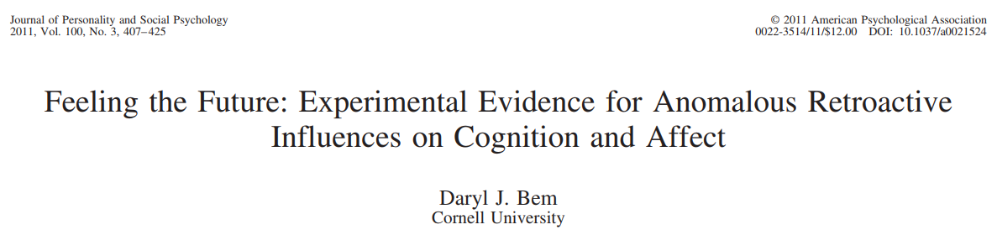
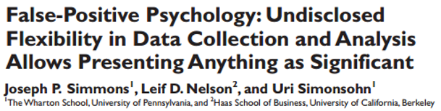
Theoretical Concerns about False Positives

Slide 4
Evidence of Replication Problems
Reproducibility Project: Psychology (OSC, 2015)
~40/100 replicated
Social Sciences Replication Project (Camerer et al., 2018)
13/21 replicated
Multiple large-scale Registered Reports

Slide 5
Just Social Psychology?

Slide 6
Just Social Psychology?
Unfortunately, no.

Slide 7
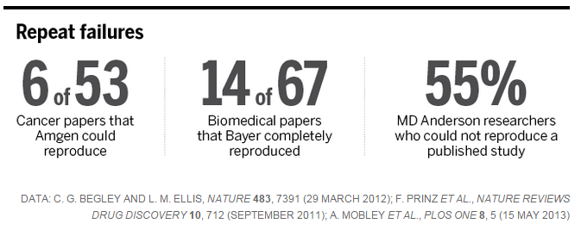
Just Social Psychology?
Unfortunately, no. Medicine:

Slide 8
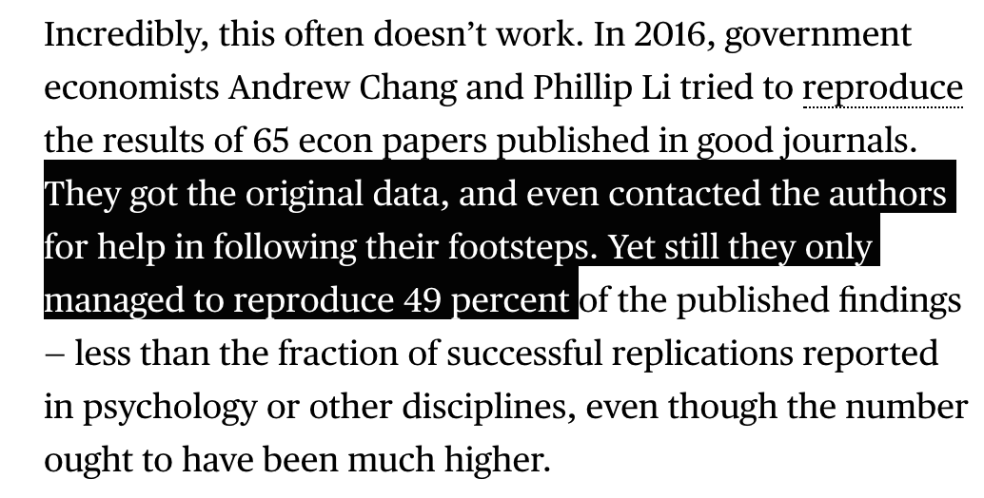
Just Social Psychology?
Unfortunately, no. Economics:

Slide 9
Just Social Psychology?
Unfortunately, no. Many others.
Why?
Because these problems are inherent to the way all scientific fields function (e.g., publication, significance testing, career advancement, human biases)

Slide 10
Just Social Psychology?
Unfortunately, no. Many others.
Why?
Because these problems are inherent to the way all scientific fields function (e.g., publication, significance testing, career advancement, human biases)
Extent differs by field.

Slide 11
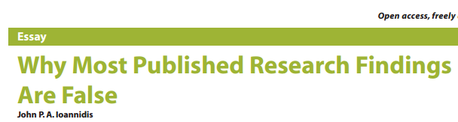
Just Social Psychology?

Slide 12
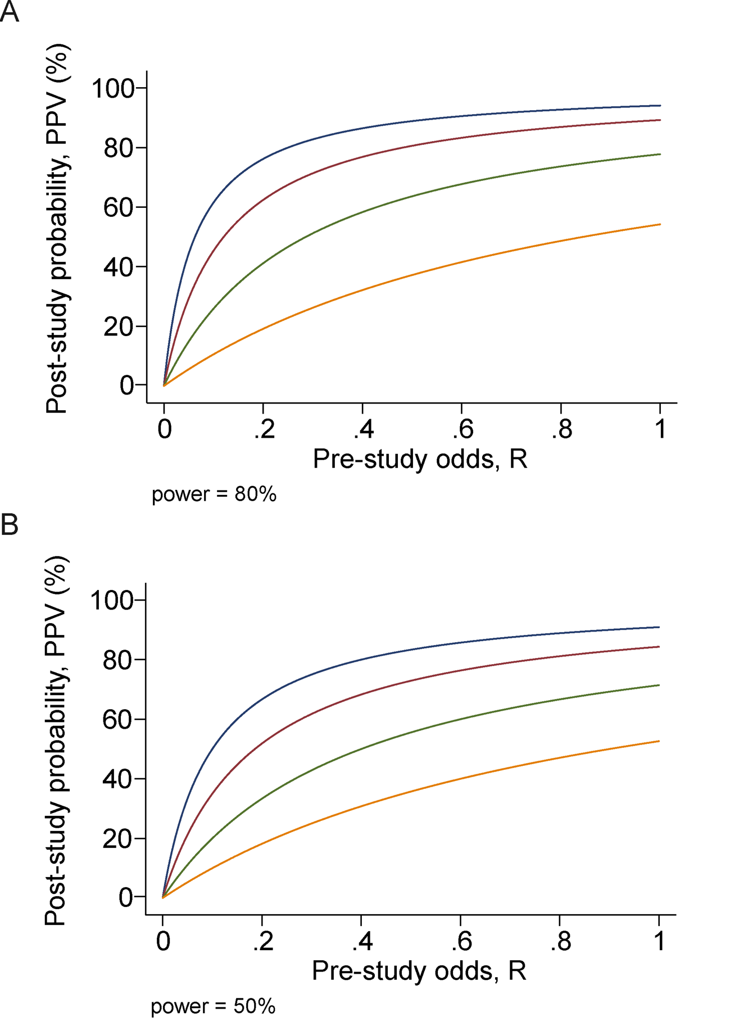
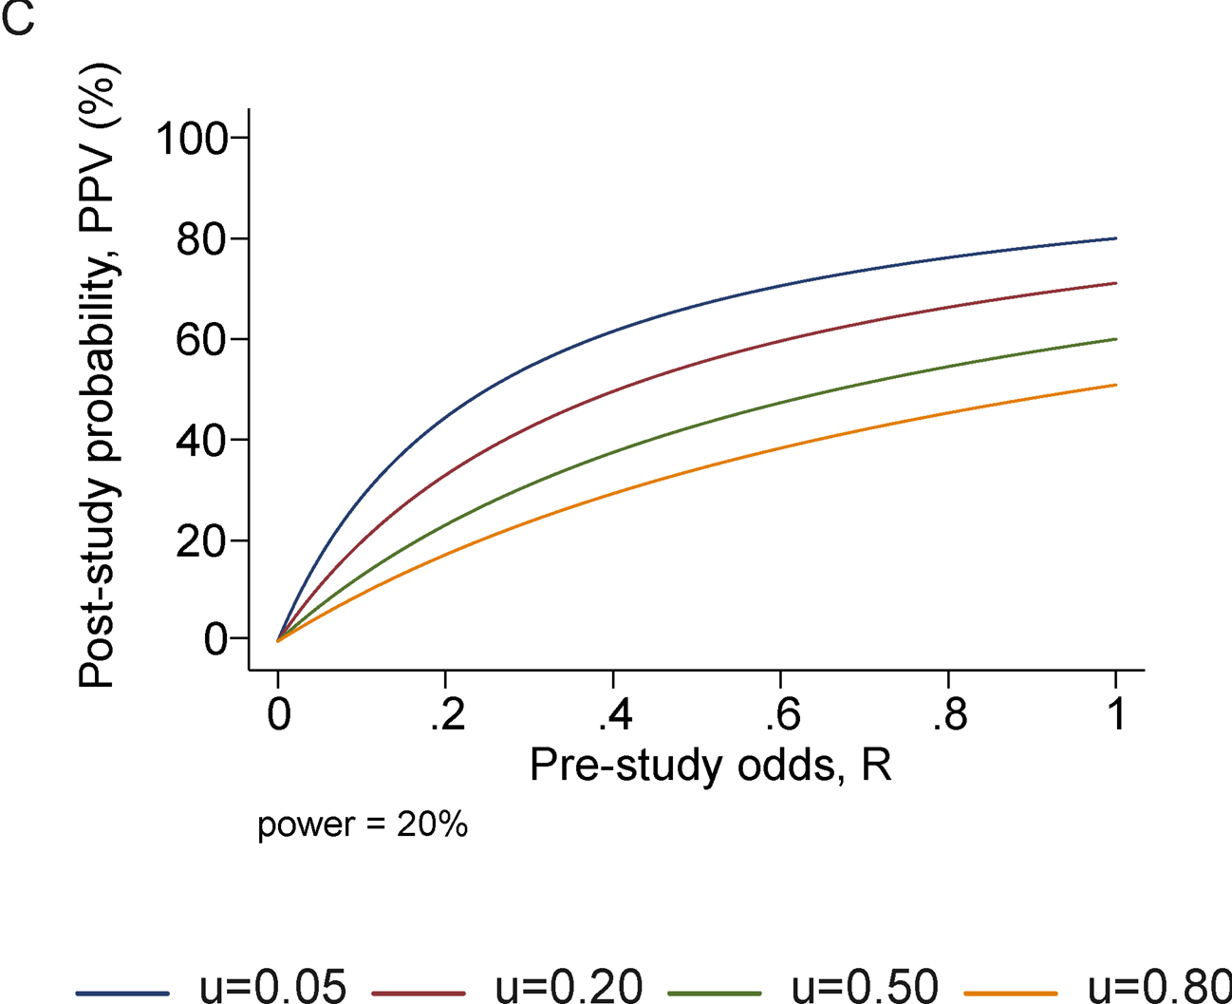
Just Social Psychology?

Slide 13
So, what’s exciting about this?

Slide 14

So, what’s exciting about this?

Slide 15
So, what’s exciting about this?

Slide 16
So, what’s exciting about this?
Because we can fix it
Redefine the field in fundamental ways
Science is still the best way of knowing
Despite replication issues, we know a LOT
…But, also know a lot less than we thought.
Imagine how much we can accelerate the pace of discovery

Slide 17
Moving toward solutions (and better understanding)
Critical to understand problems to inform solutions.
Many potential causes for replication failures
False positives
Incompetent replicators
Imprecise theory (unknown moderators)
Contextual differences
Etc.

Slide 18
Moving toward solutions (and better understanding)
Critical to understand problems to inform solutions.
Many potential causes for replication failures
False positives
Incompetent replicators
Imprecise theory (unknown moderators)
Contextual differences
Etc.

Slide 19
Many Labs Replication Projects
Large collaborations of researchers replicate the same findings.
Each project examines a different aspect of replication.

Slide 20
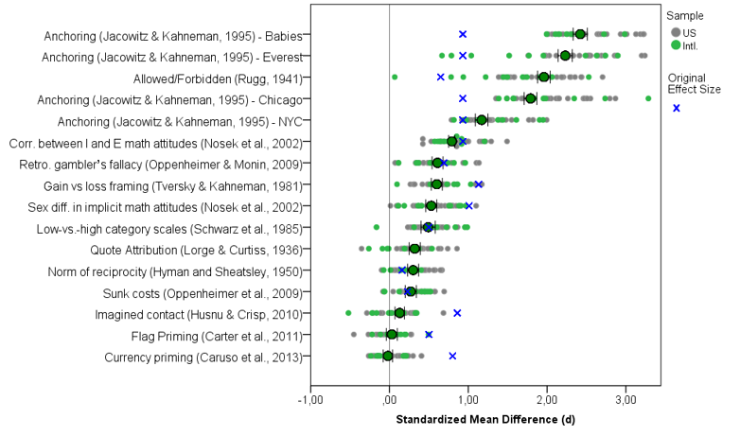
Many Labs Replication Projects
Last week you heard Many Labs 1 (Klein et al., 2014)

Slide 21
Many Labs Replication Projects
This week: Many Labs 2 (Klein et al., 2018)
4x larger, immensely more complex

Slide 22
Many Labs 2
Goal: Replicate many different studies all around the world and compare if they vary based on the sample of data collection.
How much variation should we expect?
Who should be allowed to do a replication?
Lab in US vs lab in Japan

Slide 23
Many Labs 2
Selected 28 high-impact studies
Original authors/other experts approved each one
(Unlikely a failure would be due to incompetence)
Replicated across 125 labs around the world
Adjusted per-site (translation, stimuli)

Slide 24
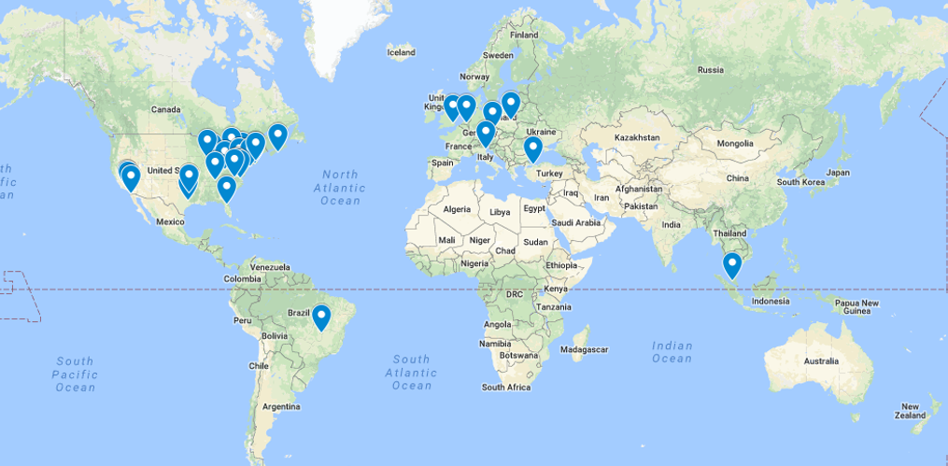
Many Labs 1 Map (2014)

Slide 25
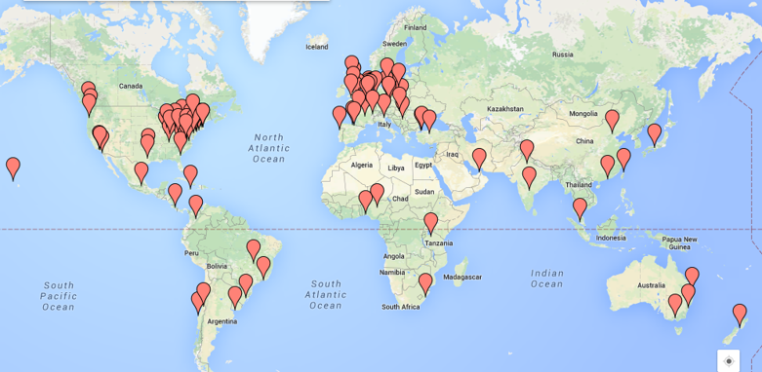
Many Labs 2 Map (2018)

Slide 26
Many Labs 2 Map (2018)
125 samples
36 countries
16 languages
15,305 participants

Slide 27
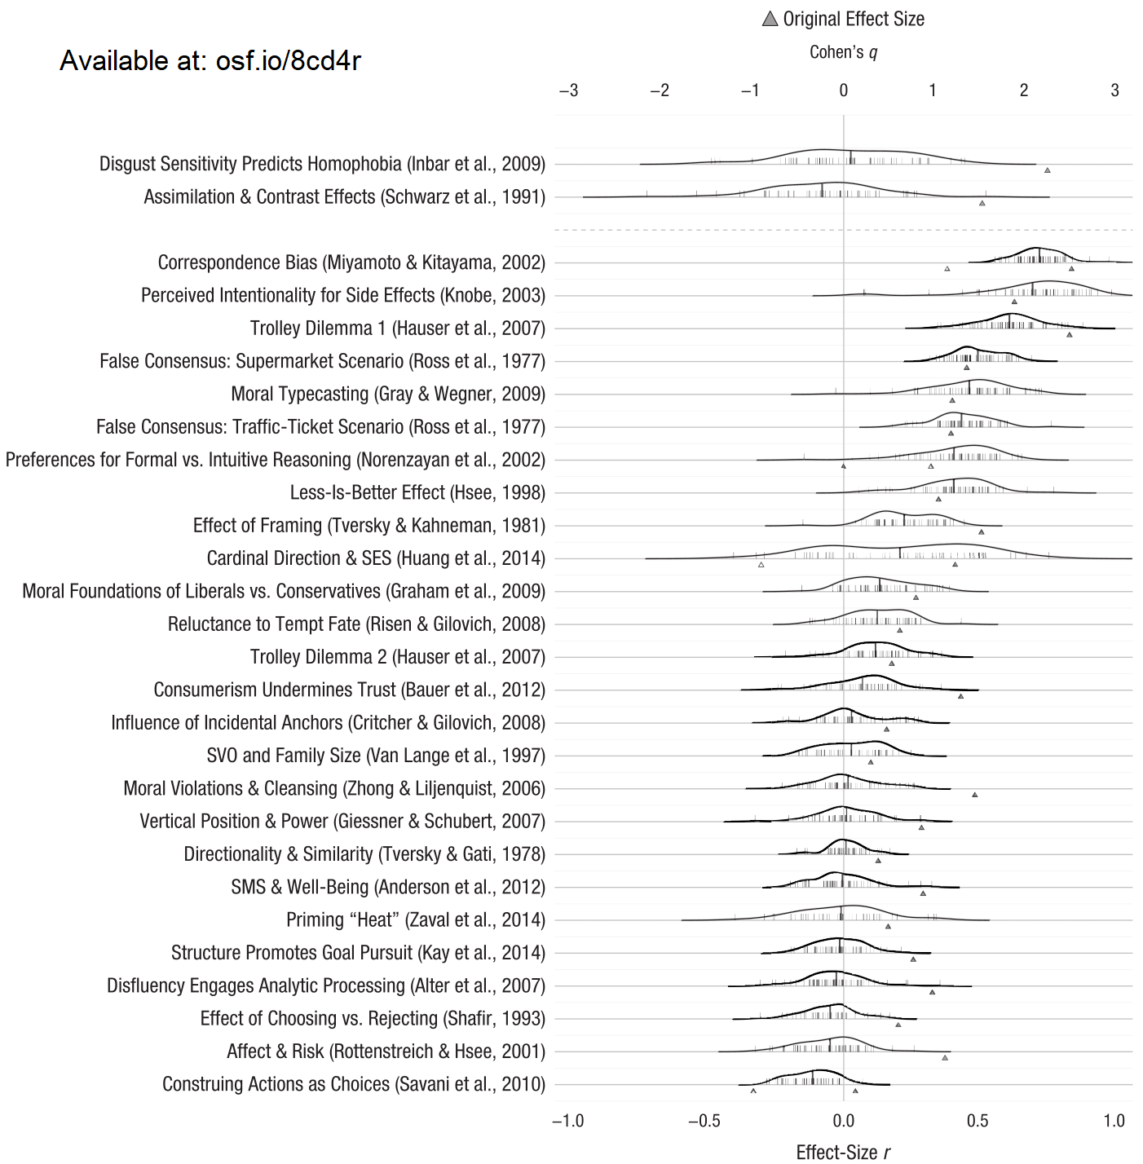
ML2 Results
14/28 successful
21/28 smaller effect size
Median original: d = 0.60
Median replication: d = 0.15
…NOT the
interesting question!

Slide 28
Did results vary by site?
Meta-analysis:
26/28 Tau ≤ 0.1
Often 0
No! (except 2)
Wait.. What?
Mostly seeing sampling error
N = ~80 per site

Slide 29
Many Labs 2 Discussion
Replication success did not depend on site
Good news!
Replication success did not depend on small variations in implementation
Replicability is a feasible goal
Does this apply to all studies?
Of course not! But sets a baseline
MUST test moderators empirically

Slide 30
Solutions
Given what we know, how do we improve replicability?

Slide 31
Solutions
Given what we know, how do we improve replicability?
Replicate (and not just in the US/Europe)
Increase statistical power
Pre-registration/Registered Reports
Open data/analysis scripts/materials
4b. Incentivize good practices
Full disclosure of results

Slide 32
1. Replicate
Helps establish:
Is effect real?
Does effect generalize across populations?
Deeper understanding of conditions necessary
Incentivizes other practices
If replication is expected, my motivation shifts from publishing to finding (and understanding) true effects (e.g., Scientific Utopia 2)

Slide 33
1. Replicate
Not enough on its own
Publication bias? Open materials?
Follow replication recipe
…and all following suggestions

Slide 34
2. Increase statistical power
Statistical power: Probability of finding an effect if it is there
Mostly depends on sample size and effect size
Historically 30-50%
Low statistical power: more false negatives AND false positives

Slide 35
2. Increase statistical power
How many participants for 80% power?
http://datacolada.org/18

Slide 36
2. Increase statistical power
How many participants for 80% power?
http://datacolada.org/18
People who like eggs eat more egg salad?

Slide 37
2. Increase statistical power
How many participants for 80% power?
http://datacolada.org/18
People who like eggs eat more egg salad?
47/cell – 94 participants total
(Cohen’s D = .58)

Slide 38
2. Increase statistical power
How many participants for 80% power?
http://datacolada.org/18
People who like eggs eat more egg salad?
47/cell – 94 participants total
(Cohen’s D = .58)
Smokers think smoking is less likely to kill someone?

Slide 39
2. Increase statistical power
How many participants for 80% power?
http://datacolada.org/18
People who like eggs eat more egg salad?
47/cell – 94 participants total
(Cohen’s D = .58)
Smokers think smoking is less likely to kill someone?
149/cell – 298 participants total
(Cohen’s D = .33)

Slide 40
2. Increase statistical power
How many participants for 80% power?
http://datacolada.org/18
People who like eggs eat more egg salad?
47/cell – 94 participants total
(Cohen’s D = .58)
Smokers think smoking is less likely to kill someone?
149/cell – 298 participants total
(Cohen’s D = .33)
Many free tools to compute this
R, G*Power

Slide 41
2. Increase statistical power
How?
Fewer studies, more participants?
Collaborate (see The Many Lab: osf.io/89vqh/, the Psychological Science Accelerator)
More powerful designs, more precise measures

Slide 42
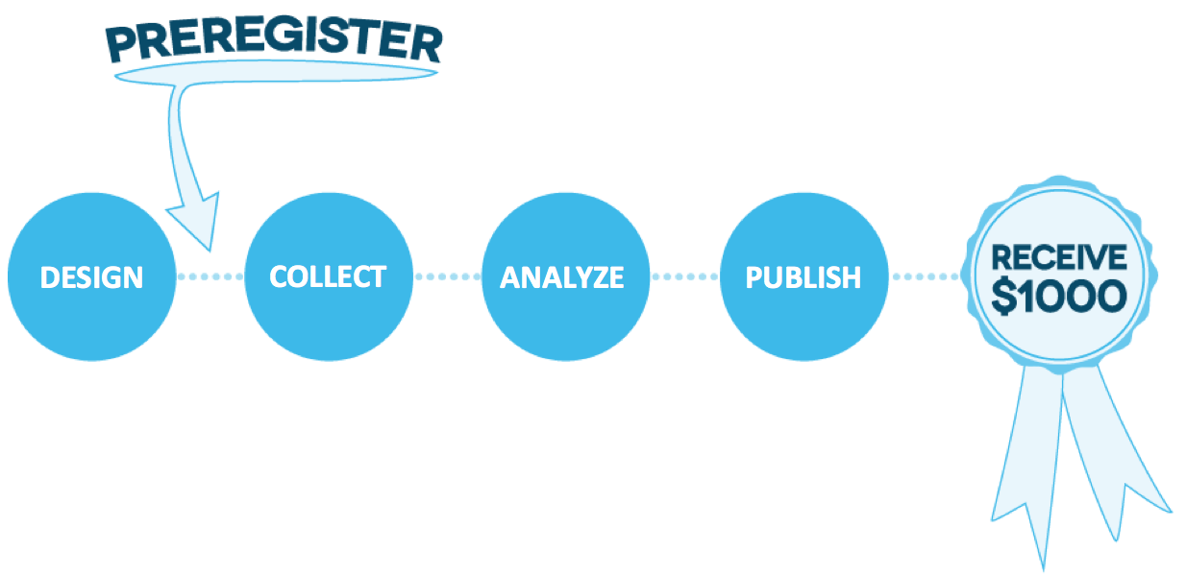
3. Pre-registration
Specify method and analysis plan in advance

Slide 43
3. Pre-registration
Specify method and analysis plan in advance
Why?

Slide 44
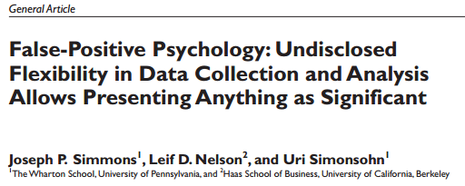
3. Pre-registration

Slide 45
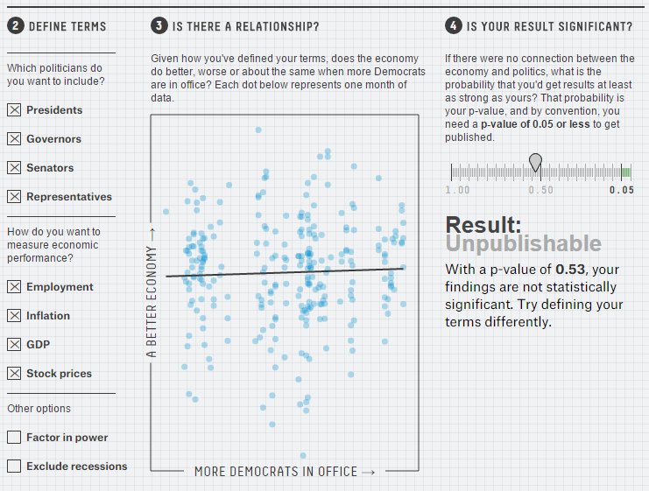
Flexibility in Data Analysis (http://fivethirtyeight.com/features/science-isnt-broken)

Slide 46
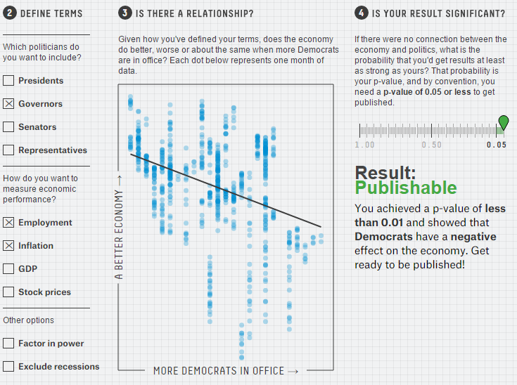
Flexibility in Data Analysis (http://fivethirtyeight.com/features/science-isnt-broken)

Slide 47
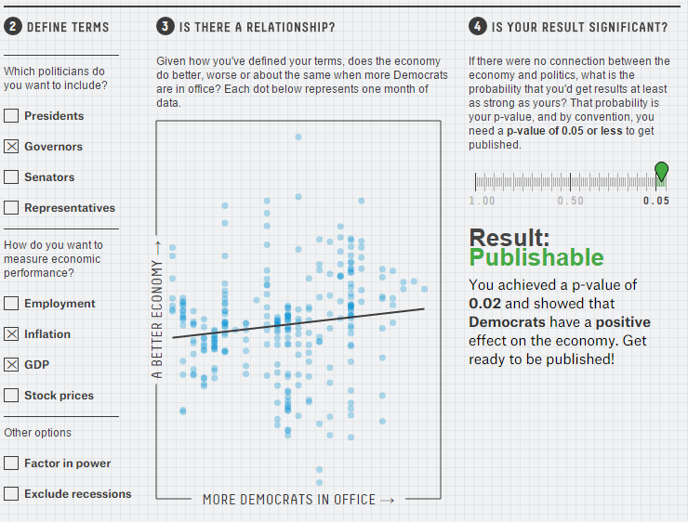
Flexibility in Data Analysis (http://fivethirtyeight.com/features/science-isnt-broken)

Slide 48
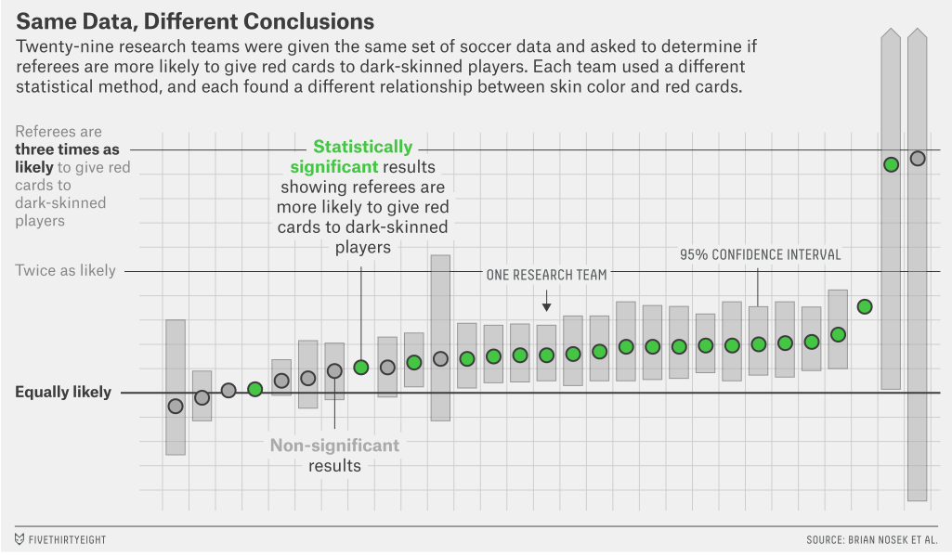
Silberzahn et al.

Slide 49
3. Pre-registration
How?
osf.io/prereg
Our lab’s workflow: osf.io/q29nf/
Aspredicted.org

Slide 50

3b. Registered Reports
Pre-registration, and also submit to a journal in advance.

Slide 51
3b. Registered Reports
Allows you to get feedback before you do everything.
Prevents publication bias (selective publication of significant findings)

Slide 52
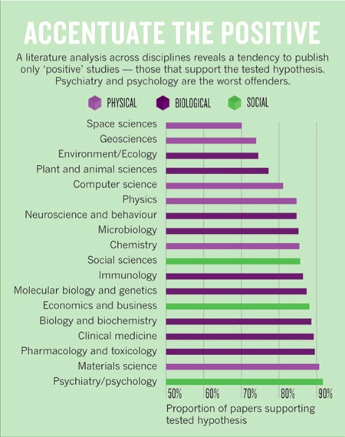

Slide 53
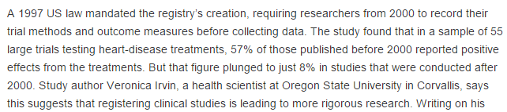

Slide 54
3b. Registered Reports
Allows you to get feedback before you do everything.
Prevents publication bias (selective publication of significant findings)
Forces agreement in advance about what is important and what constitutes evidence

Slide 55
3b. Registered Reports
Where?
Increasing adoption: cos.io/rr

Slide 56
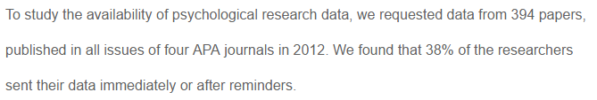
4. Open everything (data/materials/analyses)
Post data, share protocols, save analysis scripts (R, SPSS)
Facilitates exact replication
Ex: osf.io/8cd4r/

Slide 57
4. Open everything (data/materials/analyses)
Allows error-checking of analyses, verification of data

Slide 58
4. Open everything (data/materials/analyses)
Allows error-checking of analyses, verification of data

Slide 59
4. Open everything (data/materials/analyses)
How?
Plan for openness from the start
Future you will thank you
Save scripts, ensure reproducibility as you go
Follow Transparency Guidelines
https://www.collabra.org/articles/10.1525/collabra.158/

Slide 60
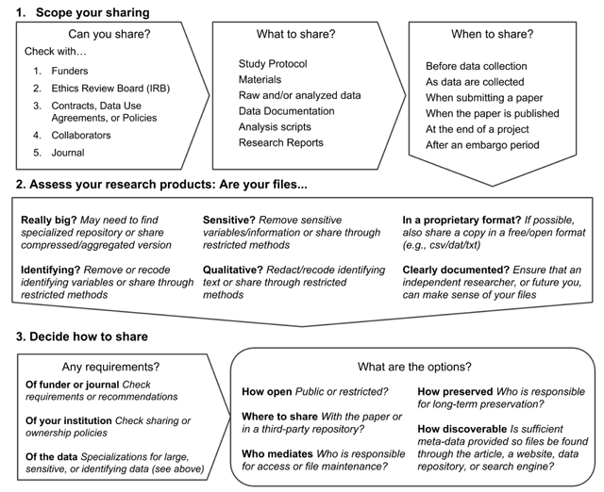
4. Open everything (data/materials/analyses)

Slide 61

4. Open everything (data/materials/analyses)
Incentive? Badges?

Slide 62


Slide 64
4. Open everything (data/materials/analyses)
Incentive? Badges?

Slide 65
4. Open everything (data/materials/analyses)
Incentive? Badges?
Some evidence this
increases citations/impact

Slide 66
4. Open everything (data/materials/analyses)
Incentive? Badges?
Some evidence this
increases citations/impact
Definitely helps catch errors
(Own experience)

Slide 67
5. Full disclosure of results
21-word solution:
“We report how we determined our sample size, all data exclusions (if any), all manipulations, and all measures in the study.”
Surface research
Include studies that “didn’t work”
JEP:G example (http://sometimesimwrong.typepad.com/)
Registered Reports (list of journals: cos.io/rr)
No publication? OSF, psychfiledrawer.org
Confidence intervals/effect size/means
DON’T obsess about p-values

Slide 68
Other solutions?
TONS of new ideas happening every day
Computational reproducibility
R Markdown
https://elifesciences.org/labs/ad58f08d/introducing-elife-s-first-computationally-reproducible-article
Machine learning
Novel presentation/communication
Shinyapps (http://shinyapps.org/apps/p-hacker/)
Continuously updating meta-analyses

Slide 69
Other solutions?
Increased connectivity/collaboration
Study Swap
osf.io/view/StudySwap/
“Many Labs” projects
Many Beds, Many Babies, Many VR, Many Numbers, Many Primates, Many EEGs, Many Classes, Many Analysts
Psychological Science Accelerator
https://psysciacc.org/

Slide 70
Conclusion
Half of published research findings are false?

Slide 71
Conclusion
Half of published research findings are false?
Workable problem
Not the first crisis

Slide 72
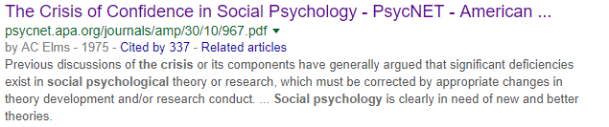
Conclusion
Half of published research findings are false?
Workable problem
Not the first crisis

Slide 73
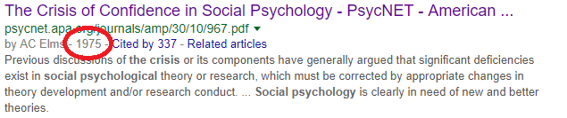
Conclusion
Half of published research findings are false?
Workable problem
Not the first crisis

Slide 74
Conclusion
Half of published research findings are false?
Workable problem
Not the first crisis
…Won’t be the last
Science is constantly evolving, which is what makes it work.

Slide 75



Thanks!
Thanks to many collaborators.
Slides will be posted (github.com/raklein)
Questions/comments?
https://raklein.me
@raklein3

